Slide 1
Semiconductor Heterostructures of monolayer transition metal dichalcogenides
Jacob Townson
Dr. Gutierrez’s
Condensed Matter Experimental Group

Slide 2
Index
Definitions
Introduction
Synthesis of Materials
Data Analysis
Experience
References

Slide 3
Definitions
Heterostructure- combination of multiple heterojunctions
Heterojunction- interface that occurs between 2 layers of dissimilar crystalline semiconductors
Band Gap- energy range in a solid where no electron state can exist, in between a valence band and conduction band
Notes:
For chemistry people, on valence and conduction bands, think orbitals

Slide 4
Definitions
Chalcogenide- chemical compound consisting of at least one chalcogen (Sulfur, Selenium, Tellurium) anion and at least one more electropositive element (ex. MoS2)
Substrate - the surface or material on which a material grows (what we make our films on)
TMD – Transition Metal Dichalcogenide

Slide 5
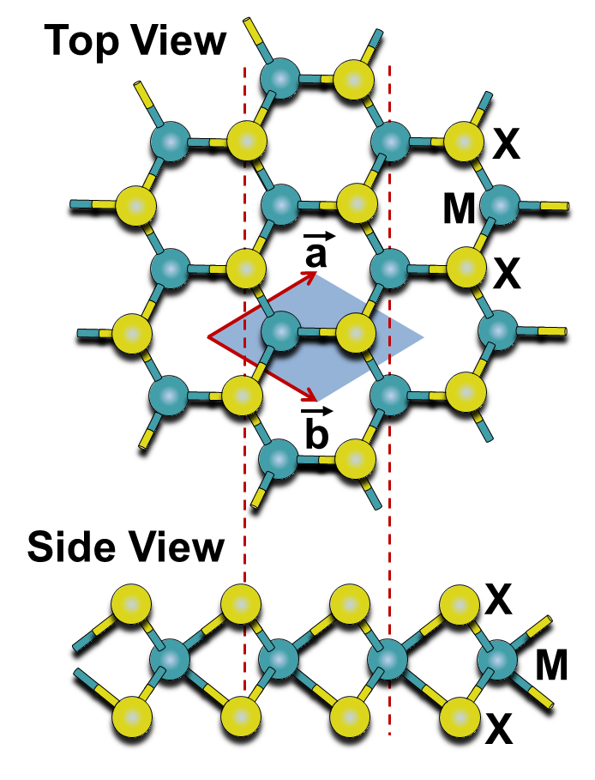
Introduction - Materials
M= Transition Metal
X = Chalcogen
8
O
Oxygen
42
Mo
Molybdenum
16
S
Sulfur
74
W
Tungsten
34
Se
Selenium
52
Te
Tellurium

Slide 6
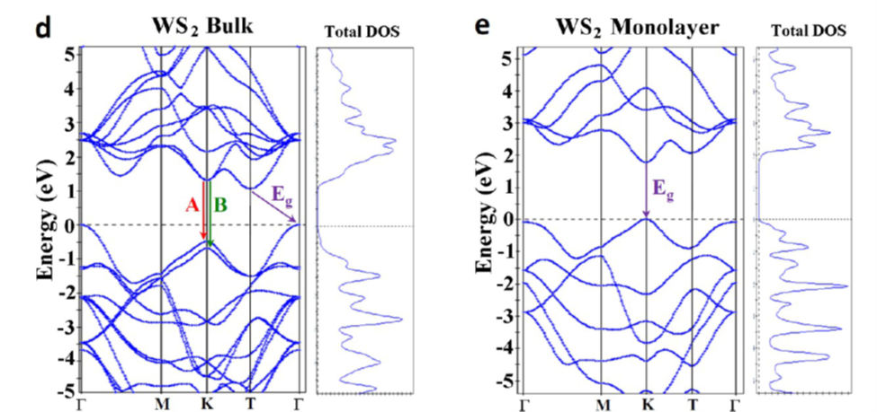
Introduction – Band Gaps
Electronic Band Structure of WS2
Note: Bottom is valence band, Top is conduction band
Ref. 1 Extraordinary Room-Temperature Photoluminescence in Triangular WS2 Monolayers
-Humberto R. Gutiérrez et al., 2012
Notes:
Material is direct if Direct Band Gap is smaller than Indirect, and the Indirect can’t actually be calculated experimentally. Indirect transition changes momentum, direct transition only changes energy. Phonon tranfers momentum to electron in Indirect transition.

Slide 7
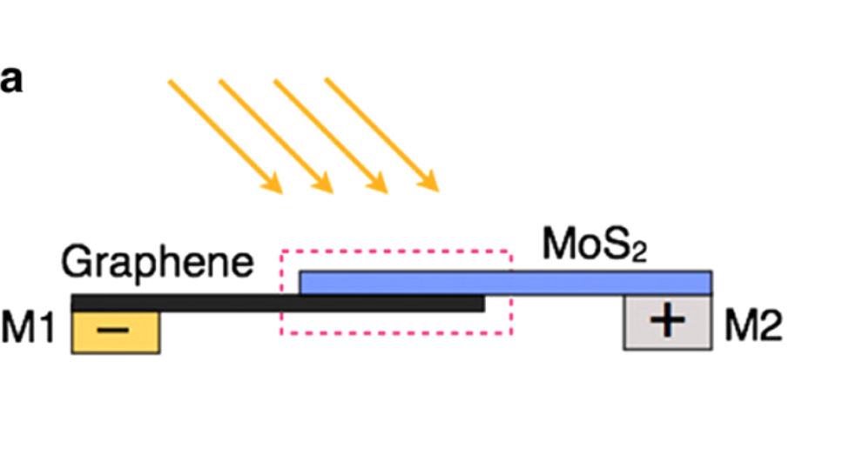
Introduction - Applications
Can be used for things such as solar cells
Optoelectric Devices
Other Low-Power Electronics
Solar Cell Layout:
Ref. 2 Extraordinary Sunlight Absorption and One Nanometer Thick Photovoltaics Using Two-Dimensional Monolayer Materials- Marco Bernardi et al, 2013

Slide 8
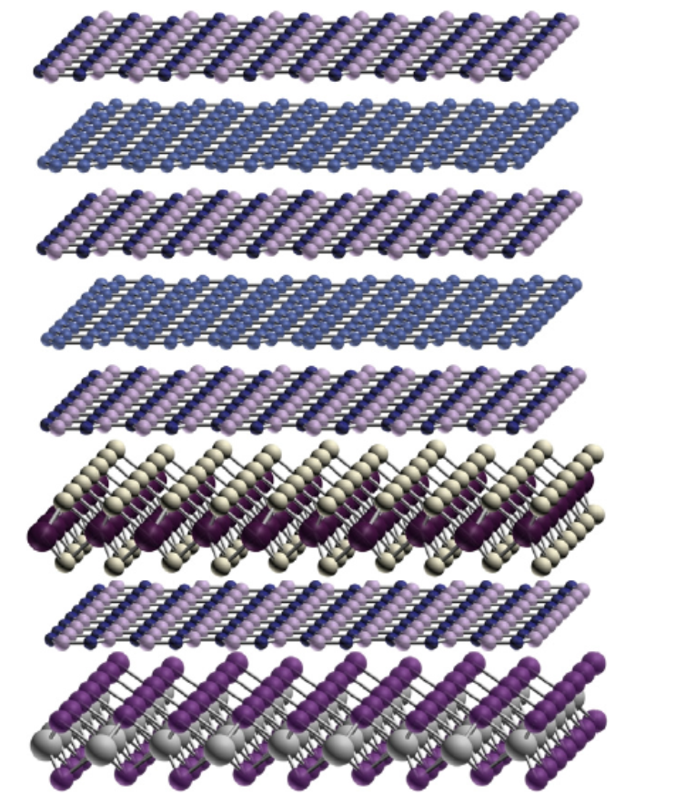
Introduction – Structure
Hypothetical 2D Stacked Crystal Heterostructure
Inplane Heterostructure layout
Ref. 3 Two-dimensional crystals-based heterostructures: materials with tailored properties- K. S. Novoselov and A .H. Castro Neto, 2012

Slide 9
SYNTHESIS
Experimental Techniques
Substrate Cleaning
Thermal Evaporation
Atmospheric Chemical Vapor Deposition (CVD)
Spin Coating
KOH Assisted Film Transfer

Slide 10
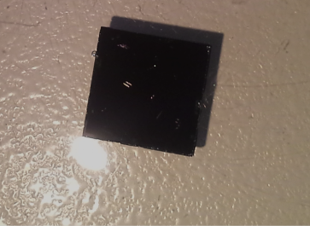

Synthesis – Substrate Cleaning
Our films are deposited on ${SiO}_{2}$
Before any depositing or growth, we clean substrates through a sonic bath with acetone then putting it in Piranha solution.
Si Substrate
Notes:
Should I call this Piranha?

Slide 11
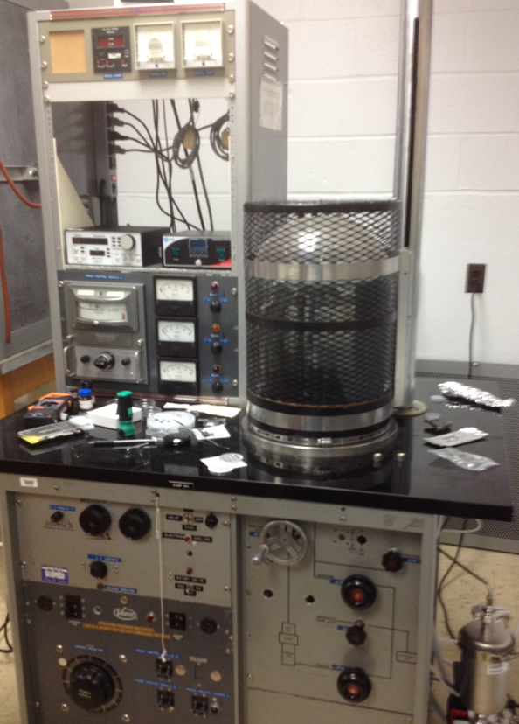
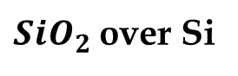
Synthesis – Thermal Evaporation
${SiO}_{2}$ over Si
The material in the boat goes through sublimation. Using this method, we deposit a single layer of the Transition Metal’s Oxide to the substrate.
MoO₃ or WO₃
Boat heated up to high temperatures

Slide 12
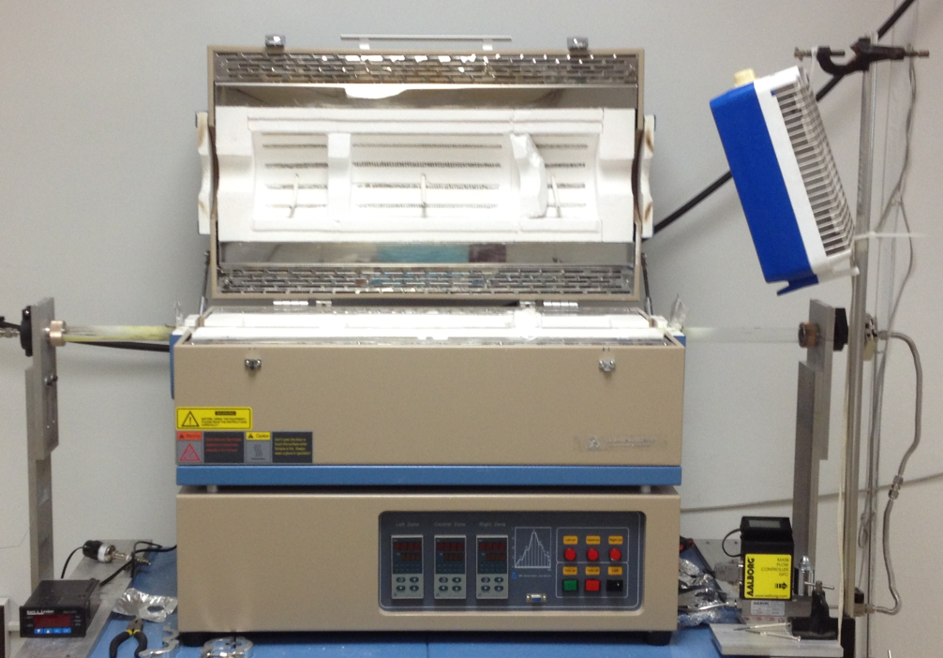
Synthesis - CVD
Chemical Vapor Deposition
N₂ or Ar+H
Using the CVD, we deposited the chalcogen atoms to the substrate with the tranistion metal, making a TMD.
Chalcogen
MoO₃ or WO₃
Three separate temperature controlled zones

Slide 13
Synthesis – Different Processes
Series A (substrates-SiO2/Si, Si <111>, Sapphire)
Thermal evaporation of 1 to 4 layer amorphous MoO3 (at 10⁻⁵ Torr) with 7.5 x 7.5 μm or 19 x 19 μm mesh TEM grids.
Thermal evaporation of 1 to 4 layer amorphous WO3 (at 10⁻⁵ Torr) without grids.
Sulfurization, Selenization, or Tellurization in three zone quartz tube furnace
Series B (substrates-SiO2/Si, Si <111>, Sapphire)
Thermal evaporation of 1 to 4 layer amorphous MoO3 (at 10⁻⁵ Torr) with 7.5 x 7.5 μm or 19 x 19 μm mesh TEM grids.
Sulfurization, Selenization, or Tellurization in three zone quartz tube furnace
Thermal evaporation of 1 to 4 layer amorphous WO3 (at 10⁻⁵ Torr) without grids.
Sulfurization, Selenization, or Tellurization in three zone quartz tube furnace

Slide 14
Synthesis – Different Processes
(1) MoO₃ Thermal Evaporation
(2) Mask removal
(2B) Chalcogenization
(3) WO₃ Thermal Evaporation
X = S, Se or Te
Series A
W_{y}Mo_{1-y}X₂
WX₂
W_{y}Mo_{1-y}X₂
WX₂
(4) Chalcogenization
Series B
WX₂
Heterostructure
Series A
Heterostructure
Series B
WX₂
MoX₂
WX₂
Notes:
Series A and B are stacked and in plane, series A with a lot of alloying, series B with little to no alloying

Slide 15
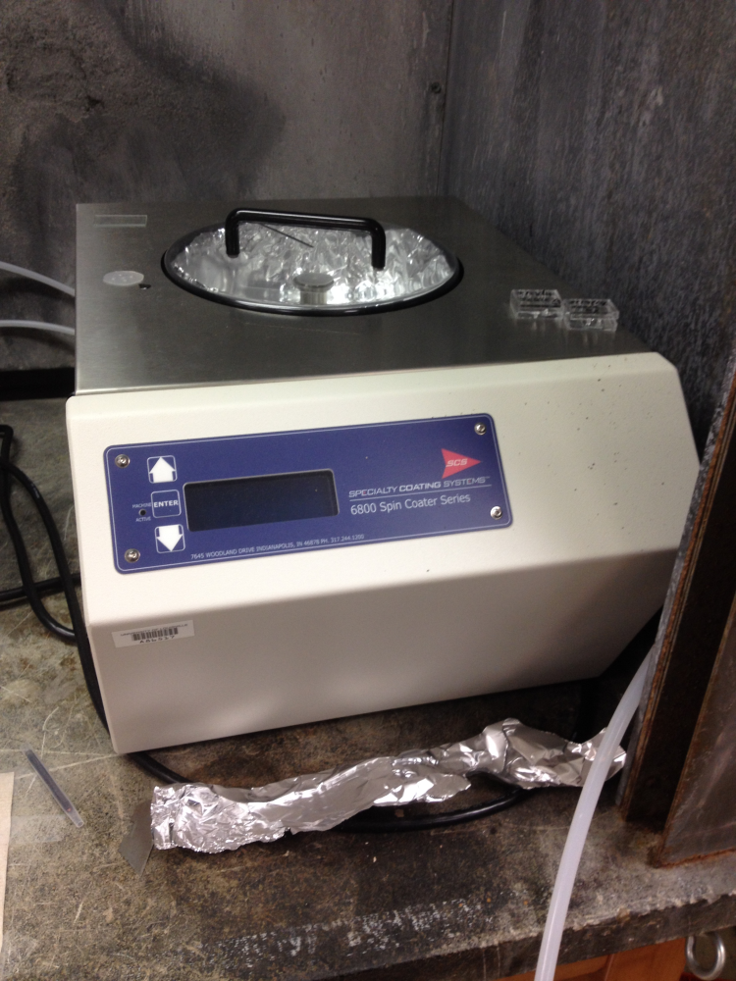
Synthesis – Spin Coating
Using the Spin Coater, we would spread a layer of PMMA over the substrate with the film on top. By doing this, we could then do a film transfer (next slide) to put our film on a different substrate such as glass for Optical Absorption Testing

Slide 16
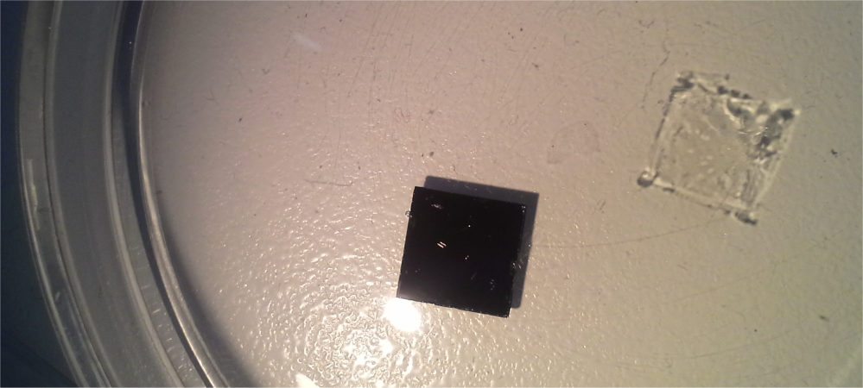
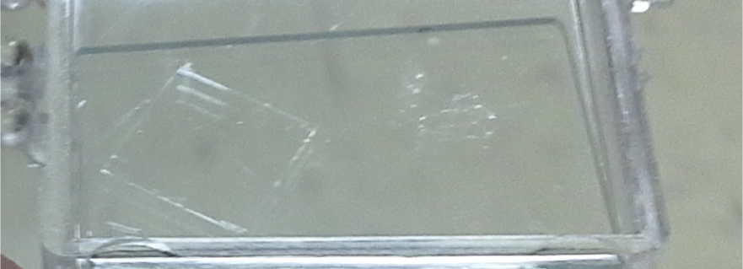
Synthesis - KOH Assisted Film Transfer
(a)
Using KOH, we could remove the film with little to no damage to a different substrate.
(b)
TMD film
transferred to
a glass substrate

Slide 17
Synthesis – Different Processes
Series C (substrates-SiO2/Si, Si <111>, Sapphire)
Thermal evaporation of 1 to 4 layer amorphous MoO3 (at 10⁻⁵ Torr) onto substrate.
Thermal evaporation of 1 to 4 layer amorphous WO3 (at 10⁻⁵ Torr) onto another substrate.
Sulfurization, Selenization, or Tellurization in three zone quartz tube furnace of each sample
Transfer one film and place that sample on top of the other sample

Slide 18
Synthesis – Different Processes
(1) TMD1, after thermal evaporation and Chalcogenization
(1) TMD2, after thermal evaporation and Chalcogenization
(2) Coat TMD1 with PMMA
(3) Detach PMMA/TMD1 from substrate using KOH
(4) Retrieve PMMA/TMD1 with TMD2
(5) Remove PMMA with Acetone
Series C
TMD1
Heterostructure
Series C
TMD2
Notes:
Series C are purely stacked heterostructures with no alloying

Slide 19
Data Analysis
Raman Spectroscopy
Optical Absorption
Not included:
TEM (Transmission Electron Microscopy)
AFM (Atomic Force Microscopy)

Slide 20
Analysis – Optical Microscope
Here we can clearly see the squares from the TEM grids used for series A and B
7.5 x 7.5 μm grids. 50x magnification.
Series A WS₂/MoS₂
Notes:
Move up next to series A and B

Slide 21
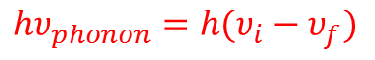
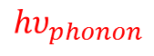
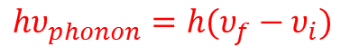
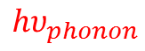
Analysis – Raman
Raman Spectroscopy is a technique used to observe low-frequency modes in a system
It is the inelastic scattering of photons after interacting with the molecular vibrations or phonons in our system
Excited Vibrational States
$$hυ_{phonon}$$
Intermediate State
$$hυ_{phonon}$$
Excited Vibrational States
hν_{f}
hν_{i}
hν_{i}
hν_{f}
Vibrational
Ground State
E = 0
$$hυ_{phonon}=h(υ_{i}−υ_{f})$$
$$hυ_{phonon}=h(υ_{f}−υ_{i})$$

Slide 22





Analysis - Raman
Raman Active modes for transition metal dichalcogenides
$$E_{1g}$$
$$E_{2g}^{1}$$
$$E_{2g}^{2}$$
$$A_{1g}$$
1 layer
We only use the $E_{2g}^{1}$ and $A_{1g}$ modes. The rules as to why are obtained from group theory in the back scattering of the photons.
It is important to note that the modes could shift in frequency depending on how many layers of a substance are on a film.
Ref. 8 Photoluminescence emission and Raman response of monolayer MoS2, MoSe2, and WSe2- Philipp Tonndorf et al., 2013
Ref. 9 Raman and resonance Raman investigation of MoS2 nanoparticles- Gitti L. Frey et al., 1999
Ref. 10 Anomalous Lattice Vibrations of Single and Few-Layer MoS2- Changgu Lee et al., 2010
Notes:
Give example of mode shift from Mo multiple layer problems

Slide 23
Analysis - Raman
What can Raman show us?
What materials we have in our film
The number layers of a certain substance
The effect of possible alloying in our films

Slide 24
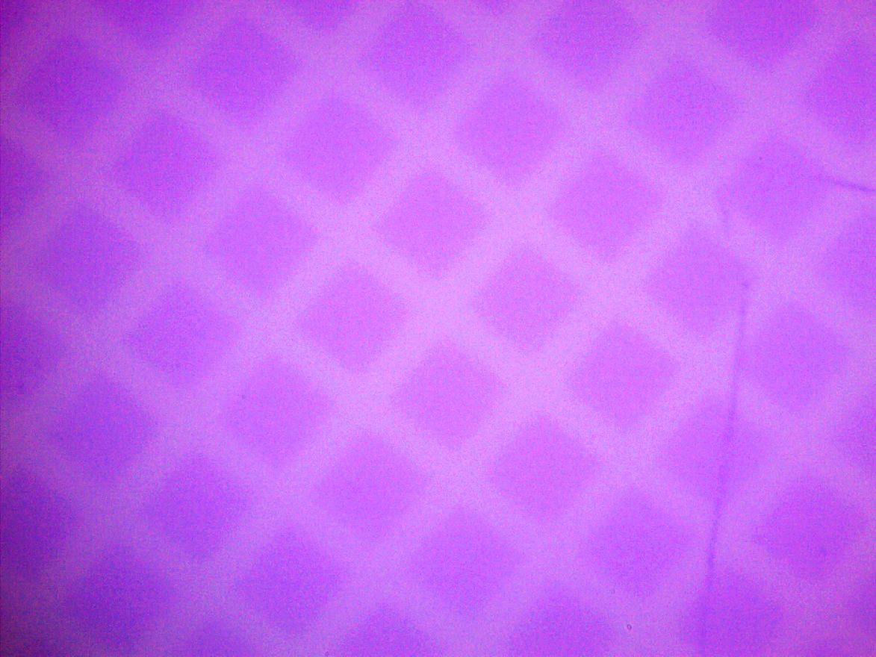
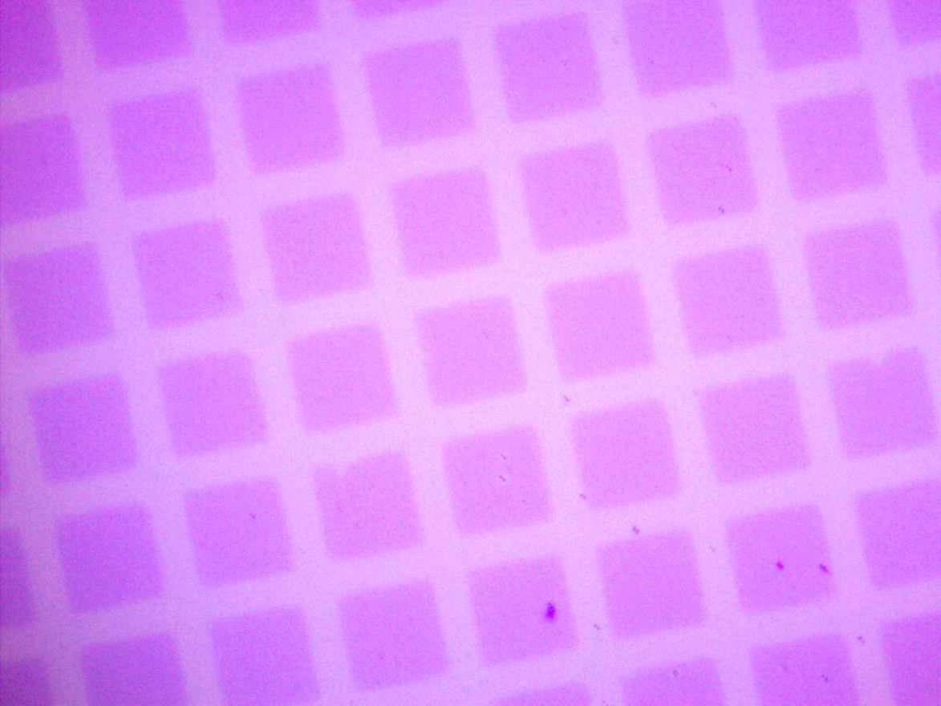
Analysis – Raman (Example)
WSe₂-MoSe₂
2
1
1
2
WS₂-MoS₂
(a)
(b)
1
Series A
1
Series A
1
Series B
Series B
1
2
WSe₂
2
WS₂
MoSe₂
MoS₂
Notes:
Note, in this example, Mo is in bulk (not single layer), but this is used to clearly show effects of alloying

Slide 25
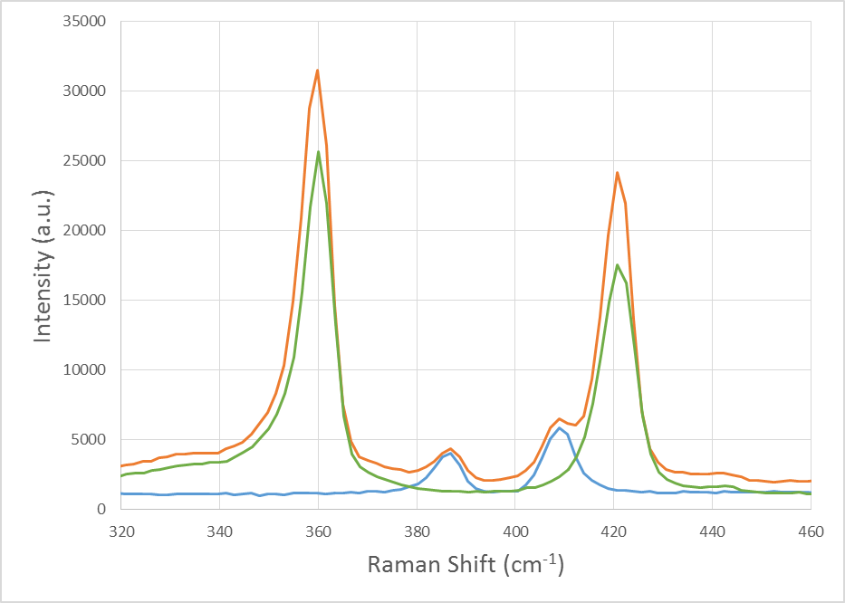
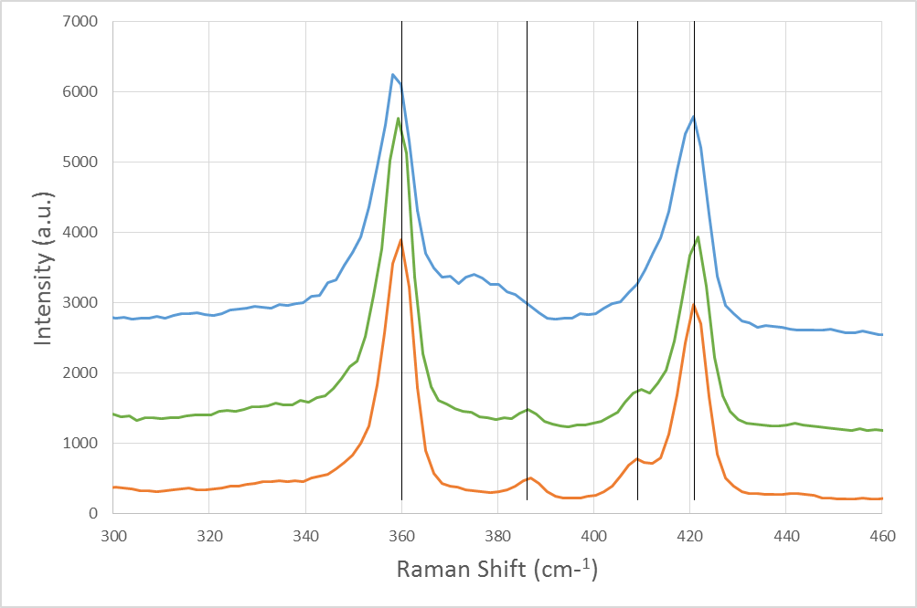
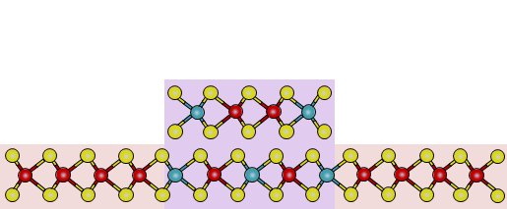
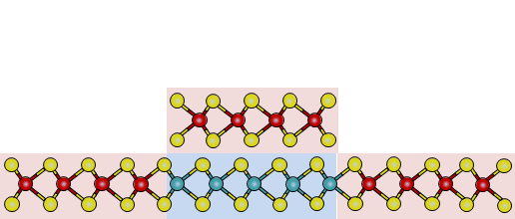
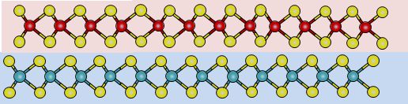
Analysis - Raman
WS2/MoS2 Series C Bilayer
MoS2 monolayer used in
Series C
WS2 monolayer used in
Series C
WS2/MoS2 Series A
WS2/MoS2 Series B
WS2/MoS2 Series C
E¹_{2g}
WS₂
A_{1g}
WS₂
A_{1g}
MoS₂
E¹_{2g}
MoS₂
Series C
Notes:
We can see properties of alloying in Series A, a little bit in Series B, and none in Series C

Slide 26
Analysis – Optical Absorption
Optical Absorption is a technique used to measure either the absorbance or percent transmission of a material.
Because our films are transparent, this is used as a method for determining the band gap.
In order to use this method, we had to put our films on glass (a transparent substrate), then account for the glass in our final calculations.

Slide 27
Analysis – Optical Absorption
Absorption/Transmission
Define Terms
I₀= initial intensity
I₀
I_{sub}
I_{sub}= intensity after transmitting
through substrate
Substrate
Sample
I_{sub_sam}=intensity after transmitting
through substrate and sample
I₀
I_{sub}
I_{sub_sam}

Slide 28
Analysis – Optical Absorption
According to the software we used to measure absorbance and transmission, these are the equations for each:
Absorbance
ABS=2-log₁₀(%T)
Transmission
T = I_{exit}/I_{initial}
%T=(I_{exit}/I_{initial})*100
I_{exit} = measured exit intensity
I_{initial} = measured reference intensity
By combining these equations, we found that to account for the glass substrate we had to divide the Transmission through the sample on the glass by the Transmission through the glass by itself
Notes:
Lambda 950 UV/Vis Spectrometer, PerkinElmer UV Winlab software

Slide 29
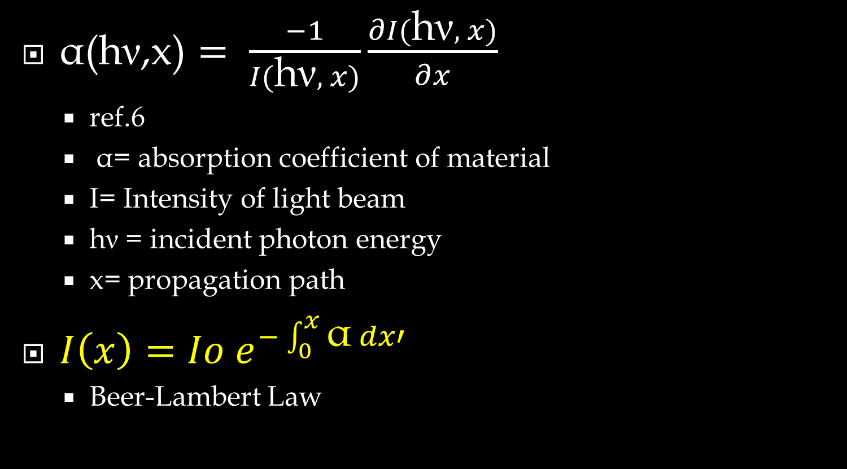
Analysis – Optical Absorption
$\text{α}\text{(}\text{h}\text{ν}\text{,}\text{x}\text{)}= \frac{−1}{I(\text{h}\text{ν}, x)}\frac{∂I(\text{h}\text{ν}, x)}{∂x}$
ref.6
α= absorption coefficient of material
I= Intensity of light beam
$\text{h}\text{ν}$ = incident photon energy
x= propagation path
$I\left(x\right)=Io{ e}^{−\int_{0}^{x}{\text{α} dx′}}$
Beer-Lambert Law
We get the Beer-Lambert Law from the absorption coefficient equation through DE. This gives us the relationship between intensity, absorption coefficient, and film thickness.
Notes:
Alpha- relative decrease of the photon energy along the propagation path

Slide 30
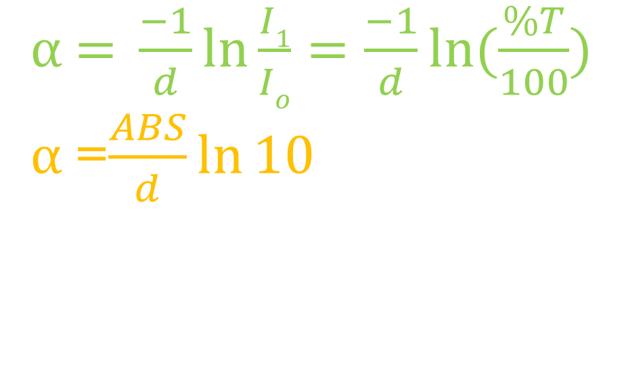
Analysis – Optical Absorption
By using the Beer-Lambert Law with the equations given to us from the software, we were able to find the equation for absorption coefficient that relates it to absorbance and transmission.
$\text{α}\text{ = }\frac{−1}{d}\ln{\frac{I1}{Io}}=\frac{−1}{d}\ln{(\frac{\%T}{100})}$
$\text{α}$=$\frac{ABS}{d}\ln{10}$

Slide 31

Analysis – Optical Absorption
Film thickness is still needed to calculate absorption coefficient.
Film thickness was estimated by using theoretical values of distance from midpoint of a chalcogen atom to midpoint of another chalcogen atom directly below it on the c-axis. The excluded pieces of the chalcogen atoms are then added on to the thickness.
chalcogen
h = distance from midpoints of two chalcogen atoms
along vertical axis
r_{c} = covalent radius of chalcogen atom
$$d=h+2r_{c}$$
r_{c}
h
transition metal
r_{c}
Ref 19. First principles study of structural, vibrational and electronic properties of graphene-like MX2 (M=Mo, Nb, W Ta; X= S, Se, Te) monolayers- Yi Ding et al., 2011
Ref 20. Electronegativity and Bond Energy - R. T Sanderson et al., 1983

Slide 32
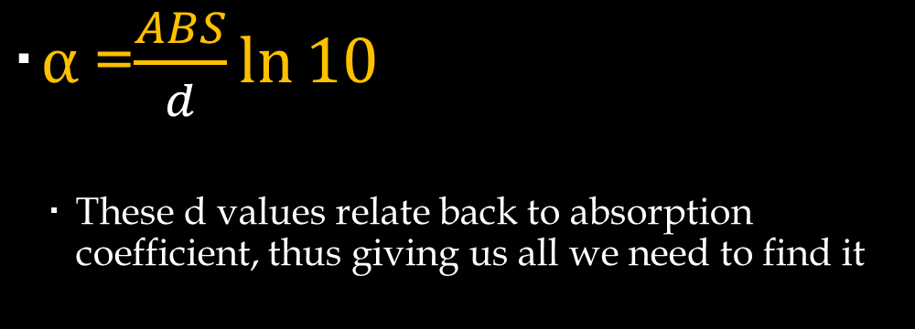
Analysis – Optical Absorption
Table 2:
Values used for film thickness d
 | h (angstrom) Ref. 19 | r_{c} (angstrom) Ref. 20 | d (angstrom)
WS2 | 3.14 A | 1.05 A | 5.24 A
MoS2 | 3.13 A | 1.05 A | 5.23 A
WSe2 | 3.36 A | 1.20 A | 5.76 A
MoSe2 | 3.35 A | 1.20 A | 5.75 A
$\text{α}$=$\frac{ABS}{d}\ln{10}$
These d values relate back to absorption coefficient, thus giving us all we need to find it

Slide 33
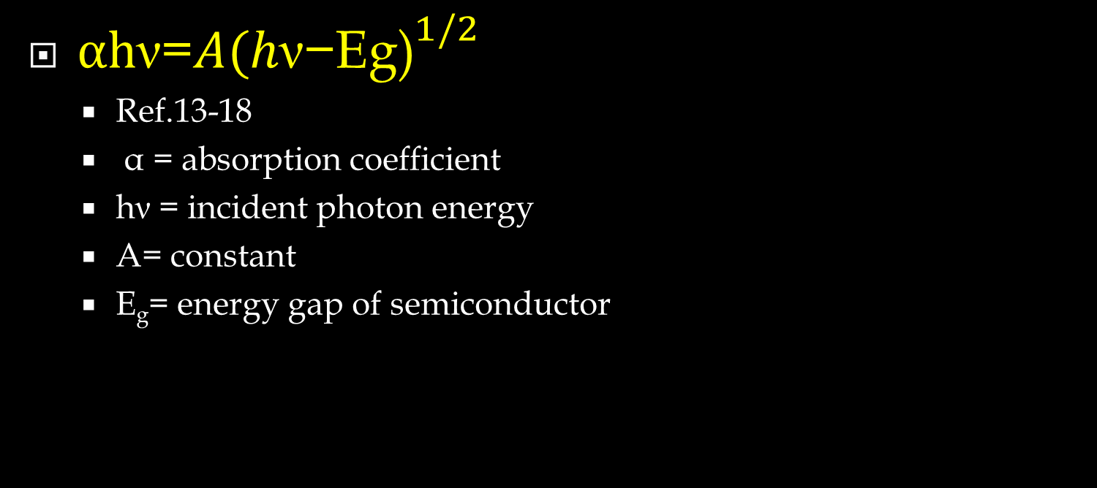
Analysis – Optical Absorption
$\text{αh}\text{ν}$=$A{(h\text{ν}\text{−}\text{Eg}\text{)}}^{1/2}$
Ref.13-18
α = absorption coefficient
hν = incident photon energy
A= constant
E_{g}= energy gap of semiconductor
Given this equation, we can now relate all of our information to the direct band gap.
Note: hv can be obtained by it’s relation to wavelength
Ref 13. Band gap determination using absorption spectrum fitting procedure- Nader Ghobadi, 2013
Ref 14. Optical Band Gap Studies of Tungsten Sulphoselenide Single Crystals Grown by a DVT Technique- D.A. Dholakia et al., 2003
Ref 15. Optical Properties of Thin Semiconductor Films- Grolik Benno, Kopp Joachim, 2003
Ref 16.CdTiO3 thin films from an octa-nuclear bimetallic single source precursor by aerosol assisted chemical vapor deposition- Shahzad Abu Bakar et al., 2012
Ref 17. Optoelectronics, by E. Rosencher, 2002, equation (7.25)
Ref 18.Optical Processes in Semiconductors- Jacques I. Pankove, 1971

Slide 34
Analysis – Optical Absorption
In this reference, it can be seen how to calculate the band gap: by extrapolating the linear portion of the graph. The x-intercept of the linear portion is the value of the direct band gap. The x intercept of the tail of the graph is the indirect band gap.
Ref 14. Optical Band Gap Studies of Tungsten Sulphoselenide Single Crystals Grown by a DVT Technique- D.A. Dholakia et al., 2003
Notes:
We plot (alpha*hv)^(1/r) where in our case r = ½ vs. eV (photon energy)

Slide 35
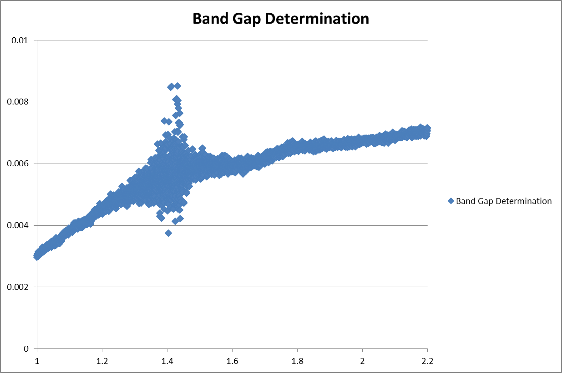
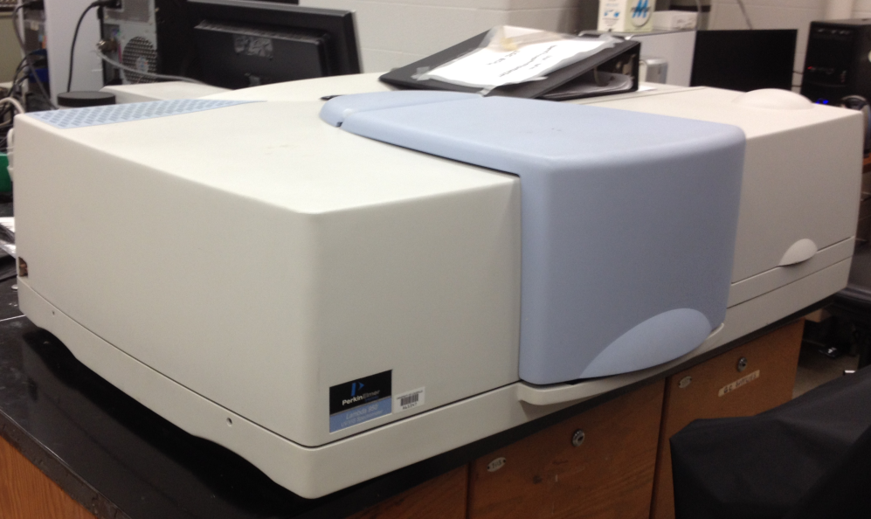
Analysis – Optical Absorption
This is the Absorbance scan done of glass by itself. Around 1.5 there is a change made in the spectrometer that can’t be avoided (under further investigation). Because of this, that area with scattered data will be in all samples.

Slide 36
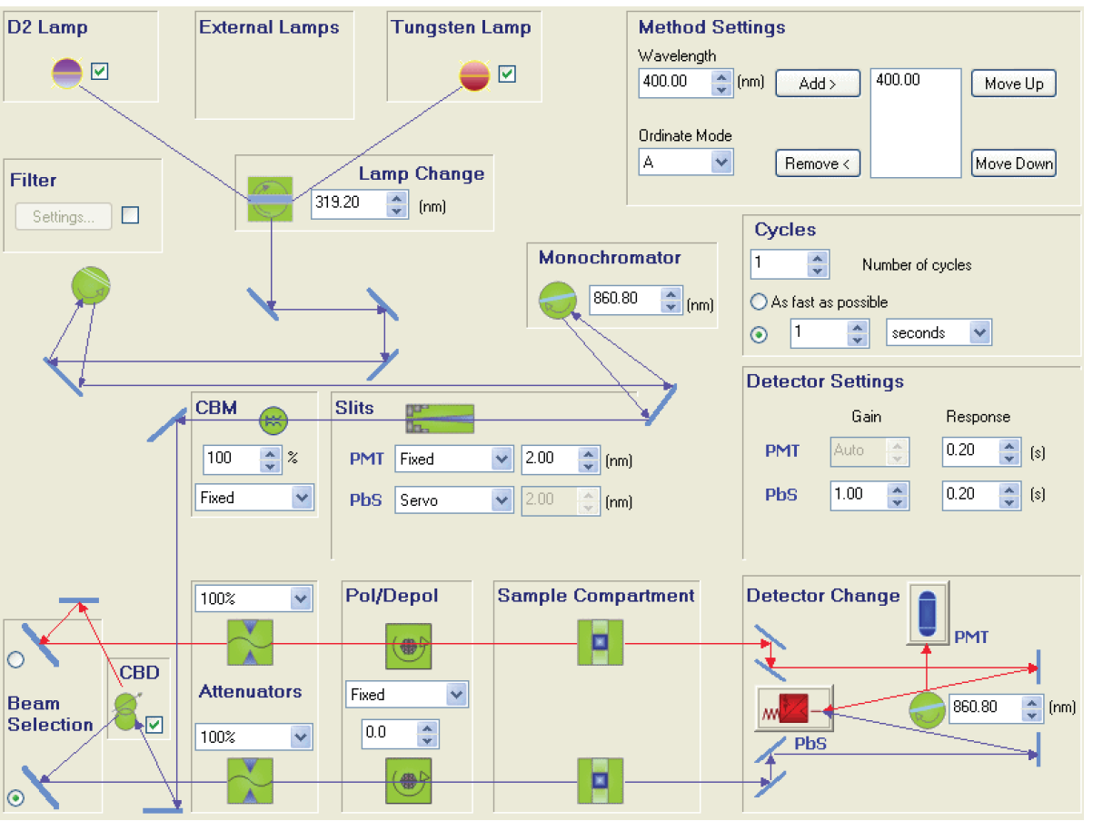
Lambda 950 schematics

Slide 37
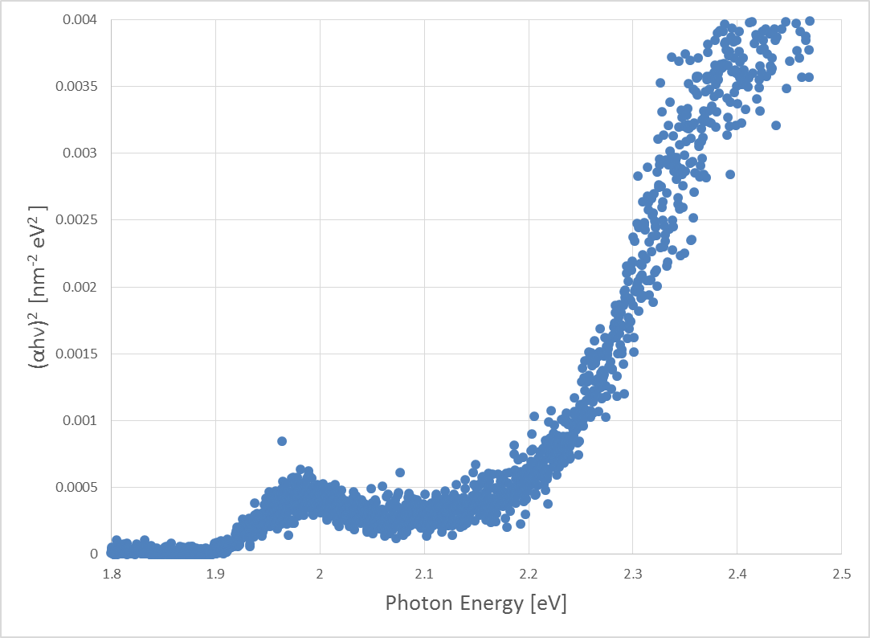
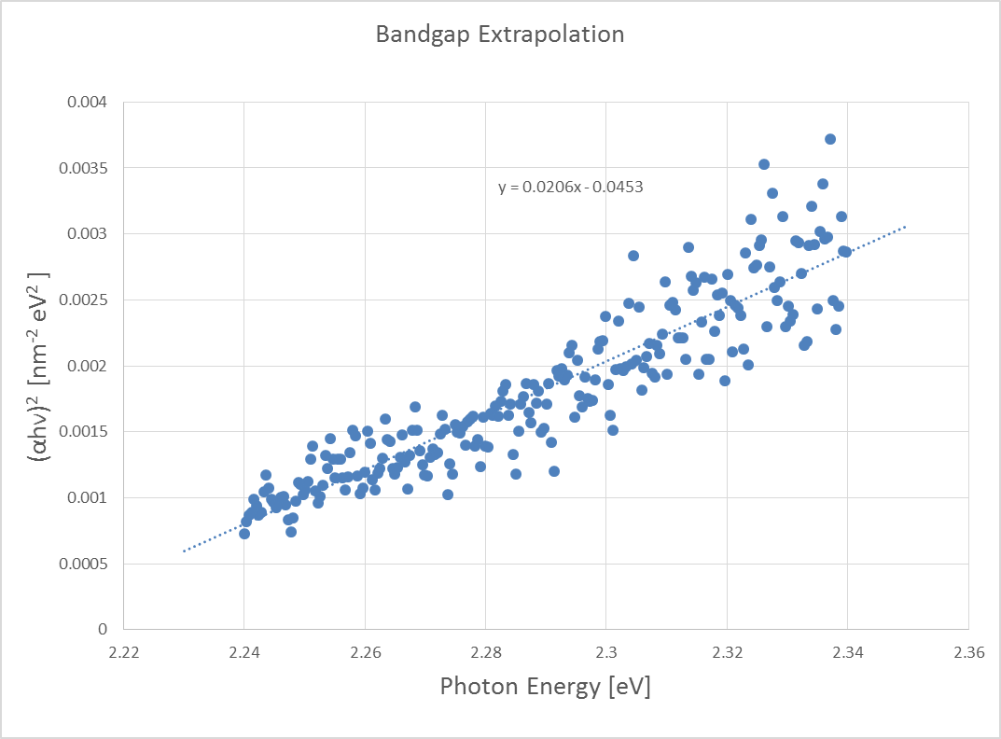
Analysis – Optical Absorption
WS2 Monolayer
E_{g}= 2.199eV
Direct Transition
Notes:
Material is direct if Direct Band Gap is smaller than Indirect, and the Indirect can’t actually be calculated experimentally. We know monolayers to only be direct. Can see exiton because we have a single layer film, if it were bulk, we would not be able to see this.

Slide 38
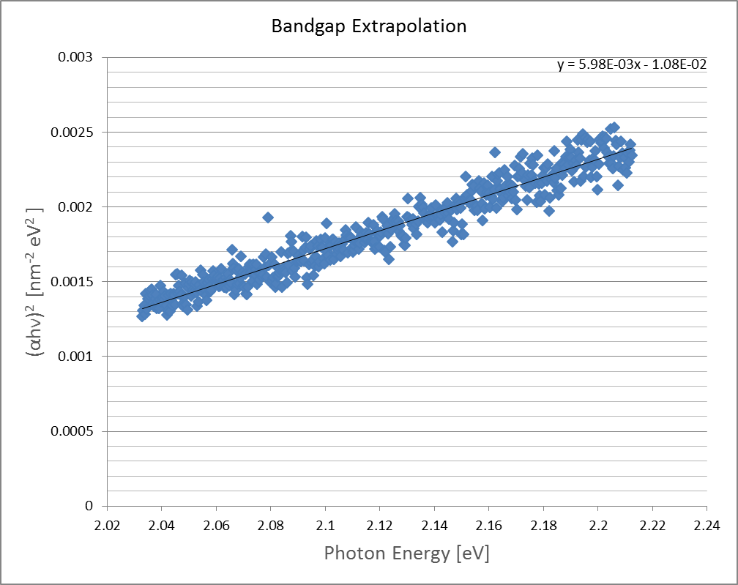
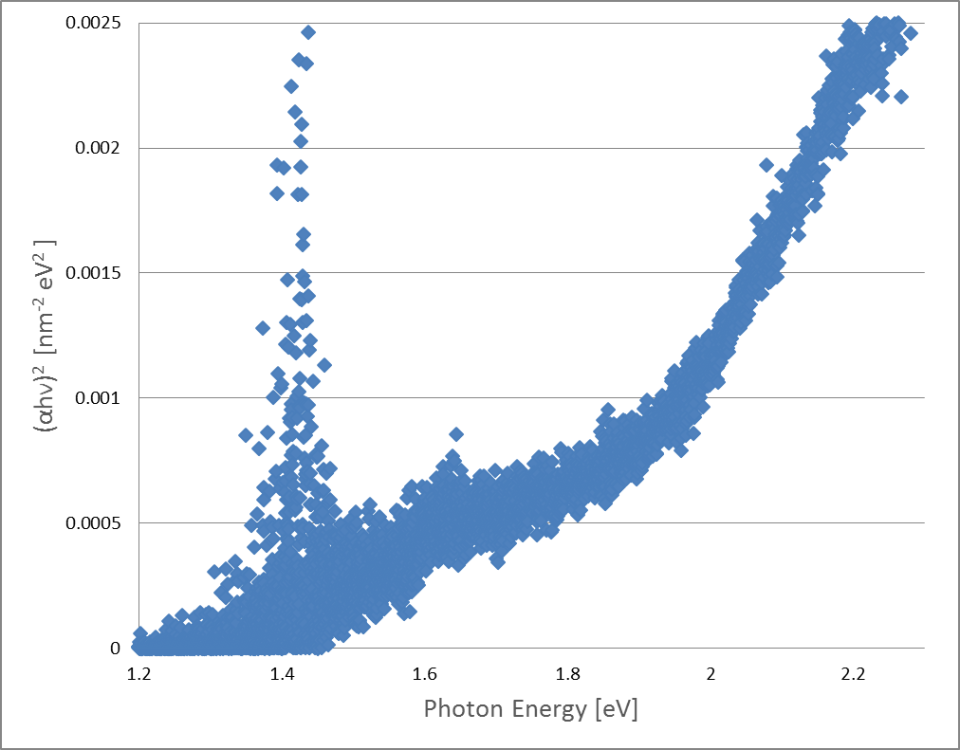
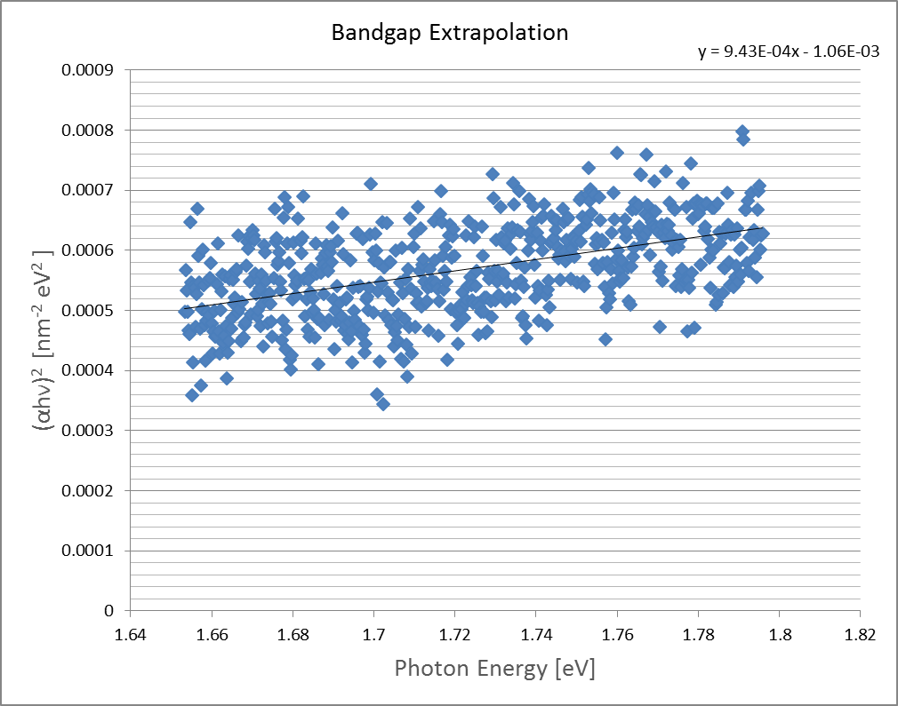
Analysis – Optical Absorption
WSe2/MoSe2 Bilayer Heterostructure Series A
E_{g} = 1.806 eV
Direct
E_{g}= 1.124 eV
Indirect

Slide 39
Analysis – Optical Absorption
Sample | Direct E_{g} Experiment | Indirect E_{g} Experiment | Eg Ref. 8 | Eg. Ref. 8 A Stacking | Eg. Ref. 8 B Stacking
WS2 monolayer | 2.199 eV |  | 1.940 eV
MoS2 monolayer | 1.829 eV |  | 1.823 eV
WSe2 monolayer | 1.722 eV |  | 1.676 eV
MoSe2 monolayer | 1.655 eV |  | 1.606 eV
WS2/MoS2 Series A | 1.990 eV | 1.573 eV |  | 1.695 eV | 1.708 eV
WS2/MoS2 Series B | 2.144 eV | 1.672 eV |  | 1.695 eV | 1.708 eV
WS2/MoS2 Series C | 1.489 eV | .795 eV
WSe2/MoSe2 SeriesA | 1.806eV | 1.124 eV |  | 1.443 eV | 1.471 eV
WSe2/MoSe2 Series B | Ongoing | Ongoing |  | 1.443 eV | 1.471 eV
WSe2/MoSe2 SeriesC | 1.86 eV | .759 eV
Ref 8. Novel hetero-layered materials with tunable direct band gaps by sandwiching different metal disulfides and diselenides

Slide 40
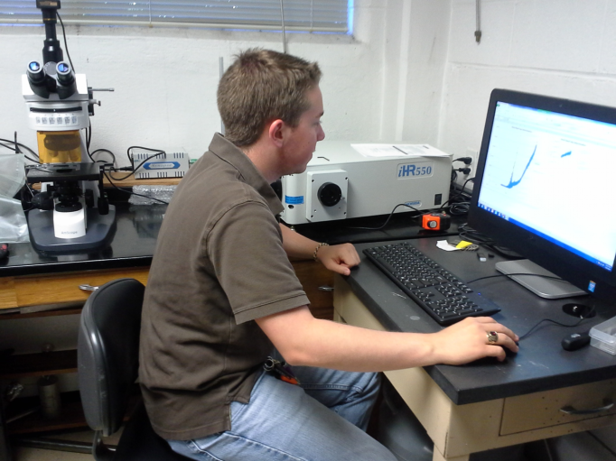
Experience
Trained on CVD multiple zone furnaces
Trained on thermal evaporators
Trained in Raman spectroscopy
Trained in UV visible optical spectroscopy
Trained in vacuum systems
Connection & gas lines, vacuum pumps (both mechanical & diffusion)
Trained in spin coating
Trained in semiconductor film transfer
Trained in substrate cleaning techniques
Exposure to both TEM and AFM

Slide 41
REFERENCES
1.) Band gap determination using absorption spectrum fitting procedure
Author: Nader Ghobadi
2.) Optical Band Gap Studies of Tungsten Sulphoselenide Single Crystals Grown by a DVT Technique
Author: D.A. Dholakia, G.K. Solanki, S.G. Patel, and M.K. Agarwal
3.) Optical Properties of Thin Semiconductor Films
Author: Grolik Benno, Kopp Joachim
4.)CdTiO3 thin films from an octa-nuclear bimetallic single source precursor by aerosol assisted chemical vapo deposition
Author: Shahzad Abu Bakar, Syed Tajammul Hussain and Muhammad Mazhar
5.) Optoelectronics, by E. Rosencher, 2002, equation (7.25)-Wikipedia
6.)Optical Processes in Semiconductors, by Jacques I. Pankove, 1971
7.) Band offsets and heterostructures of two-dimenstional semiconductors
Author: Jun Kang, Sefaattin Tongay, Jian Zhou, Jingbo Li, and Junqiao Wu
8.) Novel hetero-layered materials with tunable direct band gaps by sandwiching different metal disulfides and diselenides
Author: Humberto Terrones, Florentino Lopez-Urias, and Mauricio Terrones

Slide 42
REFERENCES
9.) First principles study of structural vibrational and electronic properties of graphene-like MX2 (M= Mo, Nb, W, Ta; X= S, Se, Te) monolayers
Author: Yi Ding, Yanli Wang, Jun Ni, Lin Shi, Siqi Shi, Weihua Tang
10.) Electronegativity and Bond Energy
Author: R. T. Sanderson

Slide 43
Thank You

